Slide 1
Concerning, unexpected or unusual behaviours in the workplace: The insider threat
‘It’s OK to Say’
Notes:
Thanks to everyone for taking the time to come along today.
Today’s training session is part of a larger programme which aims to enhance awareness of unusual and concerning behaviours in the workplace.
This programme also involves awareness raising for how you might be able to intervene if you see people behaving in unusual ways in the workplace which concern you.
We will be doing a total of ** sessions like this one, any comments you make in the session are confidential and will not be identified with you personally.

Slide 2
Learning objectives
Improve understanding of the insider threat.
Improve awareness of concerning, unexpected or unusual workplace behaviours.
Enhance knowledge of how you can report or intervene when noticing these behaviours.
Notes:
Read from slide

Slide 3
Concerning, unexpected or unusual workplace behaviour
Sometimes colleagues (including managers) might do things or talk in ways that are worrying.
Everyone has their ‘off’ days – this need not be cause for concern.
You could be best placed to identify an issue before it becomes a problem.
If you have a gut instinct where you feel something is wrong – we urge you to trust it.
Notes:
SCRIPT:
Sometimes people do or say things that are particularly unusual or out of character, which might make you worried about them. You might want to act on any concerns you have about how a colleague (and by colleague we also mean your most senior managers) has been behaving if it has caused you reason to worry for their own sake, or the harm they could do to your organisation.
There could be many reasons why someone is behaving in ways that are not entirely typical, most of them are not cause for concern - we all have our off days. Their behaviour may or may not be indicative of a broader problem; nevertheless you could be in the best position to identify an issue before it becomes a problem. If you have a gut instinct that something is wrong, do not wait until you are sure of what the issue is before you intervene, we urge you to trust your instinct instead of ignoring the issue.

Slide 4
What might be happening?
A colleague behaving in an unusual or concerning way may need support.
Any number of things might be happening…
You could intervene by talking to the individual, mentioning it to your manager or by reporting the issue.
In some cases the situation could become an insider threat if ignored.
Notes:
SCRIPT:
A colleague behaving like this might need support from within the organisation.
Any number of things might be happening with the individual, they could have problems at home, personal issues to deal with, or the problem could lie in the workplace.
There are various ways that you could intervene to help them receive this support, perhaps by talking to the individual, mentioning it to your manager or you may choose to report the issue.
In some cases, if the individual doesn’t get the support they need or the situation is not otherwise dealt with – it might become an insider threat.

Slide 5
What is insider threat?
The insider threat is the risk that legitimate access is misused, to cause damage or harm to an organisation.
Misuse of access could be:
Deliberate or accidental;
Carried out by an employee or third parties.
Organisation X is responsible for some of the most critical infrastructure in the UK –
We need to protect it
Insert picture of a scene from the organisation
Notes:
SCRIPT:
- The insider threat is the risk that legitimate access (which is typically required to do a particular job) is misused, to cause damage or harm to an organisation.
- Misuse of access could be deliberate or accidental, and it could be carried out by an employee or third parties may be given unauthorised access.
- It will be no surprise to you that Organisation X is responsible for some of the most important infrastructure in the UK. Threats can come from both outside and inside of the organisation. This campaign is an effort to protect it from internal threats.

Slide 6
What should you be aware of?
Insiders tend to behave in ways that give cause for concern:
Signs of a vulnerability/ risk
Unusual/ suspicious work activities
Unauthorised work activities
This behaviour does not automatically mean the individual is an insider!
If you see any suspicious activity or concerning behaviours, don’t try to explain it away…
– report it and we will follow it up fairly and thoroughly.
Notes:
SCRIPT:
People involved in insider activity tend to show signs of it through their behaviour, often before they have carried out the activity. These signs fall into three categories:
1) they show a potential vulnerability or risk, through for example, signs of being stressed, struggling to cope with changes in financial circumstances or major work related changes.
2) unexpected or difficult to explain work activities that cause concern (suspicious work activities);
3) work activities which are unauthorised, at least for the individual in question.
This behaviour does not automatically mean the individual is an insider! There could be a host of reasons for why someone is behaving in ways that are not entirely typical, most of them are not cause for concern. Their behaviour may or may not be indicative of a broader problem; nevertheless you could be in the best position to prevent a serious problem from developing.
If you see any activity from anyone onsite that causes you concern, whether they are a close colleague or a senior manager, don’t try to explain it away – trust your gut instinct and intervene in the way that seems most appropriate.
We now have a set of scenarios that will help to give you a better sense of how these behaviours could potentially appear, sometimes developing into insider behaviour, sometimes not. We will briefly discuss each of the four scenarios halfway though so you can share your thoughts on what is happening.

Slide 7
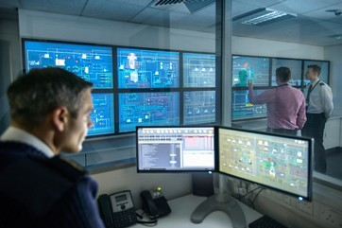
Scenario 1
An employee from an operational control room began to ask unusual questions…
Notes:
An employee from an operational control room began to ask unusual questions about several compressor stations that seemed unjustified considering his role. Ross, his colleague, had overheard several of these conversations and had noticed his work was slipping, for example he had made a few mistakes in a routine task that would only be expected of a trainee. Typically a punctual person, he had been coming in late for his shift, but often stayed on late and worked weekends, which was unusual amongst the team. Ross grew more concerned, and eventually decided to talk it through with his line manager.
---------
PAUSE: a) What do you think might be happening here? (What could explain this employee’s behaviour?)
b) How else might you interpret what is happening?
-----------------
The line manager decided to speak with the employee, and asked him whether he needed any help from himself or the company. The employee refused help, insisting that he was fine. A few days later, the line manager was contacted by Information Security. They had granted the employee access to several systems and were asking for his approval. This access was not required for the employee’s role, therefore as a result of this and the other behaviour changes, a formal review process was instigated to build a fuller picture by drawing together different sources of information. This surfaced several other worrying indicators of the employee’s involvement in malicious activity. The passwords he had requested would have enabled him access to the operational network while working from home. A compressor station had also reported that he had been lingering around a platform while making notes. The investigation revealed that this employee was preparing to cause disruption to the operational network, by oversupplying some areas and undersupplying others, with the aim of causing both physical and reputational damage. This could have cost the company millions of pounds and endangered human lives.
c) Did the outcome surprise you? (How clear was it that the employee was planning this at the point Ross spoke to his manager?)

Slide 8
Scenario 2
Jim is concerned for his colleague Georgina. Usually a very bubbly, talkative character, she has been looking tired and distant…
Notes:
Jim is concerned for his colleague Georgina. Usually a very bubbly, talkative character, she has been looking tired and distant, sometimes irritable. She seems especially aggravated after taking phone calls outside in the corridor, of which there have been many recently. Yesterday Jim walked past her on his way back to the office and she cupped her hands around the phone and started whispering, avoiding his eye contact. She was also printing something out from Cash Converters last night when most of the team had left, which has been leading him to wonder whether she might have money problems. Jim feels that something is wrong, a gut instinct that he can’t quite put his finger on… but what would his concerns actually amount to? He feels the need to talk to someone about it, but he’s worried about upsetting what used to be a close working relationship. Then again he doesn’t like the implications of ignoring it - if his instinct is right.
---------
PAUSE: a) What do you think might be happening here? (What could explain Georgina’s behaviour?)
b) How else might you interpret what is happening?
-----------------
Georgina’s husband was made redundant last month. The mortgage and loan repayments now fall on her shoulders but the figures don’t add up, there’s going to be a shortfall. They’ve been expecting a pay rise in the team for two years now – the workload always increases but never in line with her salary. Her husband knows someone who seems very interested in receiving plans of the networks, in particular those that are critical to the organisation. An offer is essentially on the table, she will receive several thousand for each key plan she can produce. Georgina can’t decide what to do, caught between loyalty to the team and a wave of debt about to hit her, something has to give soon.
c) Did the outcome surprise you? (How clear was it that Georgina was in this situation when Jim was considering whether he should share his concerns or not? )

Slide 9
Scenario 3
A senior manager who bears witness to many Board meetings has been very distracted at work recently…
Notes:
A senior manager who bears witness to many Board meetings had been very distracted at work recently. He seems withdrawn in comparison to how he used to be, and disappears frequently throughout the day, often into the photocopier room. A few colleagues noticed he was hanging around while they were discussing confidential matters; he came across nervous when one of them pointed this out.
After work one day, his secretary: Paul, overheard him in a local bar, describing the Board’s strategic plans in a derogatory way to a man he didn’t recognise.
---------
PAUSE: a) What do you think might be happening here? (What could explain this manager’s behaviour?)
b) How else might you interpret what is happening?
-----------------
Although Paul was concerned for what implications this might have for his job, he felt obliged to protect others in his team, so he decided to report this matter to someone from Personnel Security. A thorough, unbiased investigation was held which found that this senior manager had not been passing on information intentionally. In fact the changes to his behaviour of late had been due to an alcohol issue he’d developed during an unpleasant divorce. The man he’d been talking to was actually an undercover journalist, therefore there was a risk of reputational damage to the organisation, in addition to the leak of very valuable, sensitive information, which could influence the share price. This meant that the manager went through the disciplinary process, although Paul’s report also allowed the support systems to be put into place to aid his recovery.
c) Did the outcome surprise you? (How clear was it that the employee was planning this at the point Ross spoke to his manager?)

Slide 10
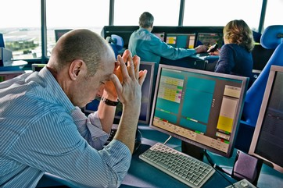
Scenario 4
Tom can be heard ranting under his breath again…
Notes:
Tom can be heard ranting under his breath again about the new manager’s incompetence. Anika, a close colleague of his, has seen him change from a laid-back person who she could always approach with a problem, to someone who seems defensive and dismissive. Apparently Tom’s access to several systems had been removed by the new manager, which he considered a ‘demotion’. He had also missed a few important meetings in which his absence was noted, in fact Anika had tried to cover for him but now she was starting to worry about what he might do next. His duties involve monitoring and securing critical assets, which if he wanted to, could be used to allow access to people intent on causing damage and disruption. This had been going on for weeks now, although it seemed to Anika that everyone was turning a blind eye. She would like to confide in someone but because the manager had upset Tom so much, she didn’t feel it fair to involve him.
……… If you were her, what would you do?
- What would you do? Why?
- What could be happening?

Slide 11
Potentially concerning behaviours: Scenario 1
Asking unusual questions
Decline in work performance / punctuality
Changes to working hours
Requesting access outside of role remit
Unauthorised use of IT systems
Unusual copying activity (taking notes)
What could this suggest?
…and now?
Notes:
Could you have predicted that this employee was preparing to cause disruption to the operational network?
(Conclusion should be – its very hard to know what is happening, but you can’t wait until you are certain of what is going on before doing something about it because the damage will probably be done by then)

Slide 12
Potentially concerning behaviours: Scenario 2
Acting ‘out of character’: talkative - distant
Signs of being stressed
Frequent, secretive phone calls
Signs of financial difficulty
Recent negative life event – actual financial difficulty
Job dissatisfaction (pay)
Suspicious contacts (interest in plans)
What could this suggest?
…and now?
Notes:
In this scenario we still don’t know whether Georgina will sell the network plans or not, but now we know what is happening in her world, she seems at particular risk of it.
(Conclusion should be – its very hard to know what is happening, but you can’t wait until you are certain of what is going on before doing something about it because the damage will probably be done by then)

Slide 13
Potentially concerning behaviours: Scenario 3
Signs of being stressed
‘Out of character’: withdrawn
Absenteeism?
Unusual copying activity?
Signs of eavesdropping
Unauthorised discussion of sensitive info
Signs of disaffection (derogatory comments)
Exploitable lifestyle (alcohol misuse)
Recent negative life event (divorce)
What could this suggest?
…and now?
Notes:
It is clear that the manager in this scenario does pose a risk to the organisation, he has been involved in insider acts although they are not intentional.
(Conclusion should be – its very hard to know what is happening, but you can’t wait until you are certain of what is going on before doing something about it because the damage will probably be done by then)

Slide 14
No definitive list of concerning behaviours
Notes:
SCRIPT:
There has been plenty of research into insider attacks which has found that people usually act in atypical ways prior to carrying out the act. From this, we have taken examples of behaviours which may be concerning, although whether they are truly concerning or not depends on the situation, the person in question and how things usually are in your place of work. It also depends on what other information you have and how frequent and extreme the behaviour is. We can not give you a definitive list of concerning behaviours that you should be looking out for. We urge you to trust your own judgement if a colleague’s behaviour has made you uneasy.

Slide 15
Other examples of potentially concerning behaviours
Changes in work-related attitudes/ behaviours:
Evidence of grievances, making direct threats, reduced loyalty to the organisation, refusal to carry out reasonable work requests/ responsibilities, lateness & absenteeism.
Signs of struggling with negative events, e.g. stress:
- At work (e.g. dismissal, redundancy) or elsewhere.
- Signs of financial hardship, substance misuse, distress.
Suspicious activity:
- Working pattern changes, requests for info outside job scope, unjustified interest in audit trails/ security measures.
Unauthorised activity:
- Accessing information/ areas/ systems that are unauthorised to the individual, e.g. removing/ copying sensitive material, misuse of passwords, betraying a position of trust.
Notes:
SCRIPT:
This list of examples is far from exhaustive, we have not and can not mention every behaviour that may indicate someone’s vulnerability to insider activity. If a colleague behaves in a way that concerns you, do not assume that because the particular behaviour hasn’t been mentioned in this training that it should be disregarded. Most importantly, you should not assume that a few behaviours like this indicate that someone is an insider! There could be any number of reasons for why someone may be behaving like this, in all likelihood they are not in the process of planning an insider attack!

Slide 16
How to make a report
Depending on:
What you have seen;
The urgency of the apparent problem;
Your own preference…
You may want to make a report in a number of different ways.
Unbiased follow-up & action
Helpline
Specific Dept.
Security
Line manager
Notes:
SCRIPT:
If you decide to report, the place or person you decide to take your information to will depend on what your preference is, the urgency of the situation and where you think the issue is best handled. It will also depend on whether you want to discuss the matter first to decide on the best way forward. However you may be surprised to learn that we feel the first stage of making a report – especially when you do this via the helpline or a manager – should be to explore the issue more thoroughly and consider what action should be taken. This does not necessarily mean making a report at this stage unless you want to. However for particularly urgent issues, you may want to contact security as a first priority.

Slide 17
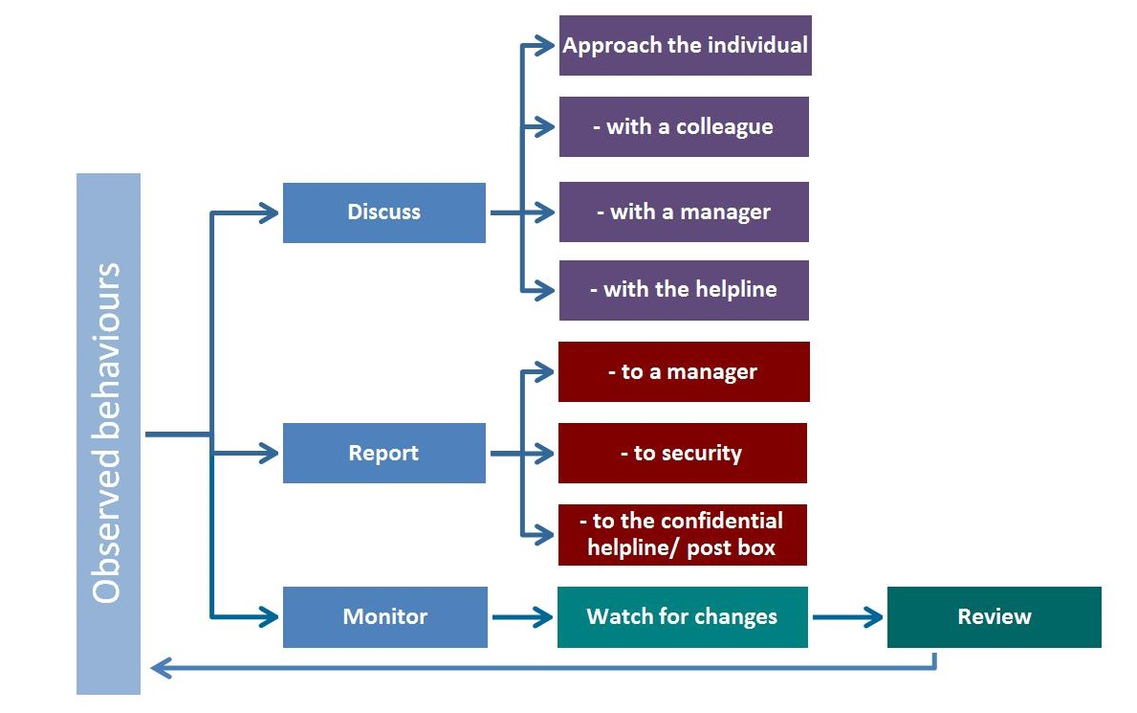
When to intervene/ report
You may want to discuss with a colleague or approach the individual.
Reports will be followed-up thoroughly.
You do not need to judge whether your concerns are right or wrong - that is our job.
Notes:
SCRIPT:
You may want to reflect on what you have seen, which might involve discussing the issue with colleagues or approaching the individual who has concerned you, to gain a clearer impression of what is going on.
If you are unsure about what to do, we would urge you to report the issue because it will be followed-up thoroughly at this point. You do not need to judge whether your concern is right or wrong, that is the job of the review process which will follow your report.

Slide 18
The confidential helpline
Meet the helpline team…
Insert details of who to contact and how
Insert picture of relevant staff or department
Notes:
SCRIPT TO BE AMENDED ACCORDING TO ORGANISATION’S REPORTING MECHANISM(S). NOTE TONE, FRIENDLINESS, AND ENSURE PROCESS BEHIND THE SCENES IS OUTLINED:
Hi, I’m Jackie. I’m one of a team of advisors who takes calls on the confidential helpline, and I’d like to tell you a little bit about how it works. We are here to help with any concerns you might have about how a colleague has been acting. They might have been doing or saying things that have caused you reason to worry for their own sake, or for the harm they could do to this organisation or its customers. You can find our telephone number on the Info-net.
Feel free to call us for a chat – you can use this as an opportunity to discuss the issue and find a way forward. This may mean making no official report at this stage. We also understand that you might want complete confidentiality. In all but exceptional circumstances, we can assure you of this. In fact if you call for an off-the-record discussion, you don’t even need to give your name.
Once we have received information, we follow it up thoroughly. This is a fair, objective process which explores what course of action will benefit everyone involved. We don’t mind if you’re not sure of what the problem actually is – whether it is serious or not; it is often quite difficult to be certain in these situations. We can help you to make sense of your concern and decide what to do next. Where we can, we will give people who have made a report an idea of the actions to follow from it. I think if someone has made the effort to contact us with a concern, we owe it to them to take it seriously.

Slide 19
Features of the reporting system
Soundboard
- Help & guidance
Discussion of a way forward.
Joint consideration of whether an official report is necessary.
Complete confidentiality assured, during both your discussions and any follow up.
Reports will be followed up fairly
Follow ups assess what actions will benefit all concerned.
People will receive indication of the actions resulting from their reports, wherever possible.
Confidential
- Protection from harm
Follow-up
- Considered action
Feedback
- Assurance of action
Notes:
Read from slide

Slide 20
Why you shouldn’t ignore your concerns
By intervening/reporting, you could prevent a problem from developing.
An ignored problem could harm the individual, their co-workers, the team or the organisation.
Insider attacks could threaten your own job security or personal safety.
By looking out for each other, we also look after ourselves and our long-term interests.
Insert case study pertinent to your organisation, if possible
Notes:
Script:
If someone is acting in a way which concerns you at work it is likely to be a concern for the company as well. By intervening or reporting, you could prevent a problem from developing. There could be negative consequences for the individual but also for his/her co-workers, the team or the organisation as a whole if the issue goes unnoticed. Such negative consequences may include increased workload, stress and absenteeism.
These conditions could raise the potential for mistakes being made and accidents occurring. In this environment, serious mistakes and accidents could do untold damage considering the responsibilities we have in our work. Many of these cases can be avoided with early intervention.
Although the prevalence of attacks from within an organisation tend to be underreported, research into insider attacks carried out in the US Research found a negative financial impact was experienced in the range of five hundred dollars to more than ten million by 81% of organisations.
Insider attacks could therefore pose a threat to your own job security or personal safety. By looking out for each other, we also look after ourselves and our long-term interests.

Slide 21
Points to take away
PLEASE DO:
Intervene when a colleague’s behaviour has unsettled/ concerned you, e.g.
Discuss it with someone you trust
Approach the individual
Report it.
Intervene in the way that seems most appropriate.
Intervene because you care.
PLEASE DO NOT:
Ignore what is happening
Assume that unusual behaviour equals an insider – there could be another explanation
Wait until you are certain of what is happening before you intervene
Take the investigation into your own hands
Notes:
Read bullet points

Slide 22
Thank you!
© Crown Copyright 2016.
The content of this Programme is crown copyright. No content may be copied, republished, uploaded, posted, publicly displayed, encoded, translated, transmitted or distributed in any way (including ‘mirroring’) to any other computer, server, website or other medium for publication or distribution or for any commercial enterprise, without NPSA’s express prior written consent.

